Slide 1
Misleading data
Thinking critically with maths

Slide 2
How our teaching resources are designed for the classroom

Slide 3
I can critically analyse a graph.

Slide 4
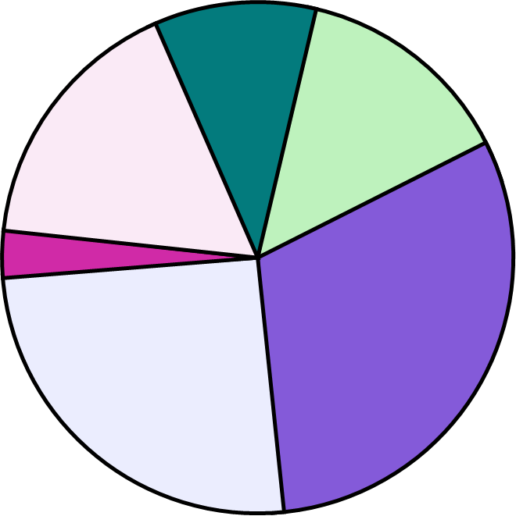
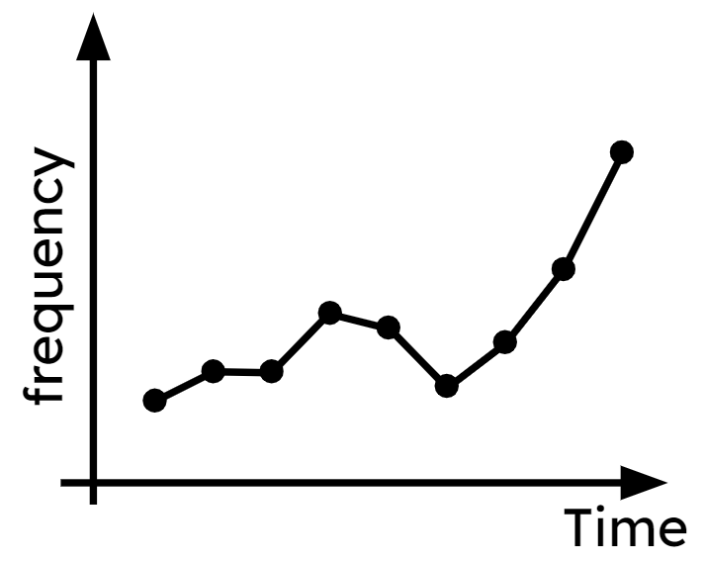
A pie chart (pie graph) is a circular graph where sectors represent different groups proportionally.
Time series graphs show data over a time period. The time period is always shown on the x-axis. Data points are joined chronologically by line segments.

Slide 5
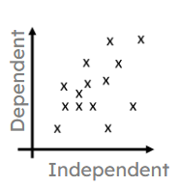
A scatter graph is a visual representation for bivariate data. It can be useful when determining the nature of the relationship between the two variables.

Slide 6

Misleading data
Misleading graphs
Misinterpreting graphs

Slide 7


Misleading graphs
Graphs are used regularly in all sorts of industries.
What industries can you think of which use graphs?
Where do you see graphs in your life?
Any company will use graphs to track trends/ profits.
Many companies use graphs for advertising.
Public services, journalists and politicians use graphs to convey information to the public.
My smart watch creates graphs out of my fitness data.
Sofia
On the news.
On packaging of products.
On adverts.
And my phone uses graphs to track my data usage.

Slide 8
Misleading graphs
Why are graphs useful?
They can be easier to read than lines of data.
They can sort data into an order.
They can be easy to interpret and draw conclusions from.
They can compare sets of data or show trends over time.
They can help predict future events.
Graphs are often used because they are visually appealing.
This means people can draw conclusions without needing to analyse the data thoroughly.
However this can lead to the misuse or misinterpretation of graphs.

Slide 9
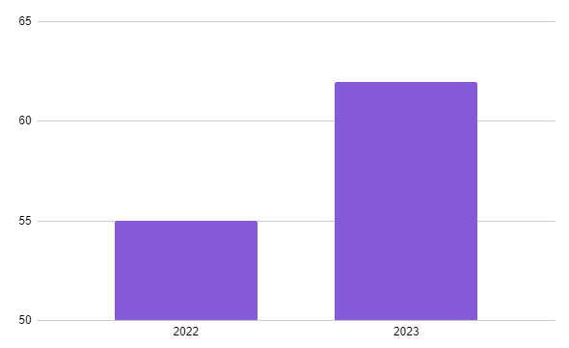

Misleading graphs
Average daily ice cream sales.
This graph shows that average daily ice cream sales for my local ice cream shop more than doubled from 2022 to 2023.
Jacob
Frequency
Is Jacob correct?
year
No, double 55 is 110 and the 2023 figure is between 60 and 65.
Why do you think Jacob said this?
The second bar is more than double the height of the first bar.
At a glance it looks like the sales have jumped considerably in 2023.

Slide 10
Misleading graphs
Average daily ice cream sales.
This graph shows that average daily ice cream sales for my local ice cream shop more than doubled from 2022 to 2023.
Jacob
Frequency
year
The scale on the y axis starts at 50 not at 0.
This skews the scale and can make small differences look more significant than they are.

Slide 11
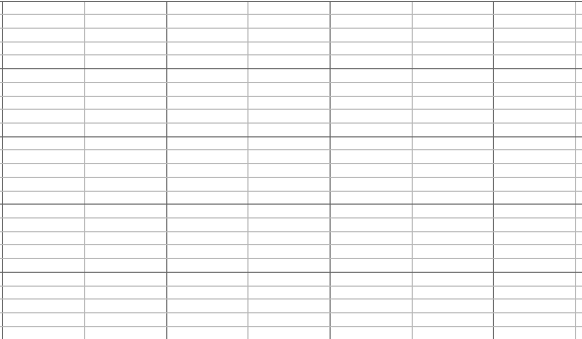
Misleading graphs
A local newspaper writes this headline.
‘Local school sees devastating drop in number of pupils studying History at GCSE.’
Give a reason why the graph may not support this headline.
120
×
×
×
The y axis has a broken scale.
Although the graph seems to drop this is only 8 fewer pupils than 2022 and 4 less than 2020.
110
Number of pupils
×
100
2020
2021
2022
2023
year

Slide 12
Misleading graphs
A local newspaper writes this headline.
‘Local school sees devastating drop in number of pupils studying History at GCSE.’
You may have also considered:
Some year groups may have fewer students anyway.
The word ‘devastating’ is used to create emotion and is not related to data.
120
×
×
×
110
Number of pupils
×
100
2020
2021
2022
2023
year

Slide 13
Misleading graphs
Using a broken scale, inconsistent scale or even no scale at all on the y axis can be misleading when comparing values on a graph.
There are times when using a broken scale may be necessary to analyse trends and variation in data, especially when the data takes large values.
However it is important not to make conclusions based on proportion if the graph does not start at 0 with a consistent scale.
Keep an eye out for information or adverts which use a broken scale to influence your interpretation of data.

Slide 14
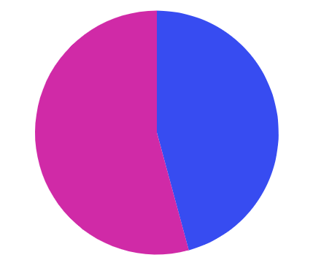
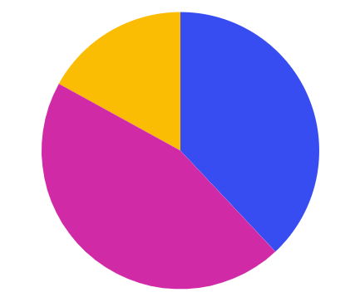
Misleading graphs
Sometimes we see graphs which are not just misleading but actually drawn incorrectly to try and influence opinion.
This pie chart shows the percentage of votes for two main parties in an election. What is the problem with this graph?
Other
17%
Adding in the remaining votes makes the difference between the two parties look less.
Pink party
45%
Blue party
38%
Blue party
38%
Pink party
45%
Pie charts should add to 100%.

Slide 15
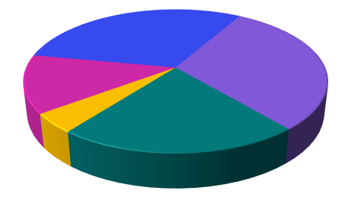
Misleading graphs
Jacob has created this pie chart about how long he spends on each activity on a Monday.
Wow Jacob you watch far too much TV on a Monday!
School
Sofia
Gaming
Sleep
TV
What is misleading about the way this chart is drawn?
Travel
The pie chart is at an angle with TV at the front. This makes it look bigger than it is.
It is really difficult to compare the different proportions in a 3D pie chart. This means they can be used to mislead the reader.

Slide 16
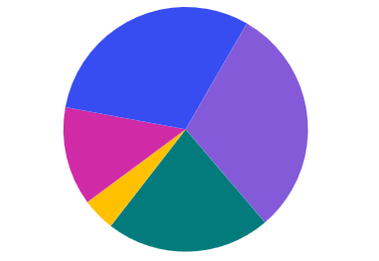
Misleading graphs
If we use a 2D pie chart the data would look like this:
School
School
Gaming
Sleep
Sleep
Gaming
TV
Travel
TV
Travel
I still think you watch too much TV Jacob but it does not look quite so bad from this angle.

Slide 17
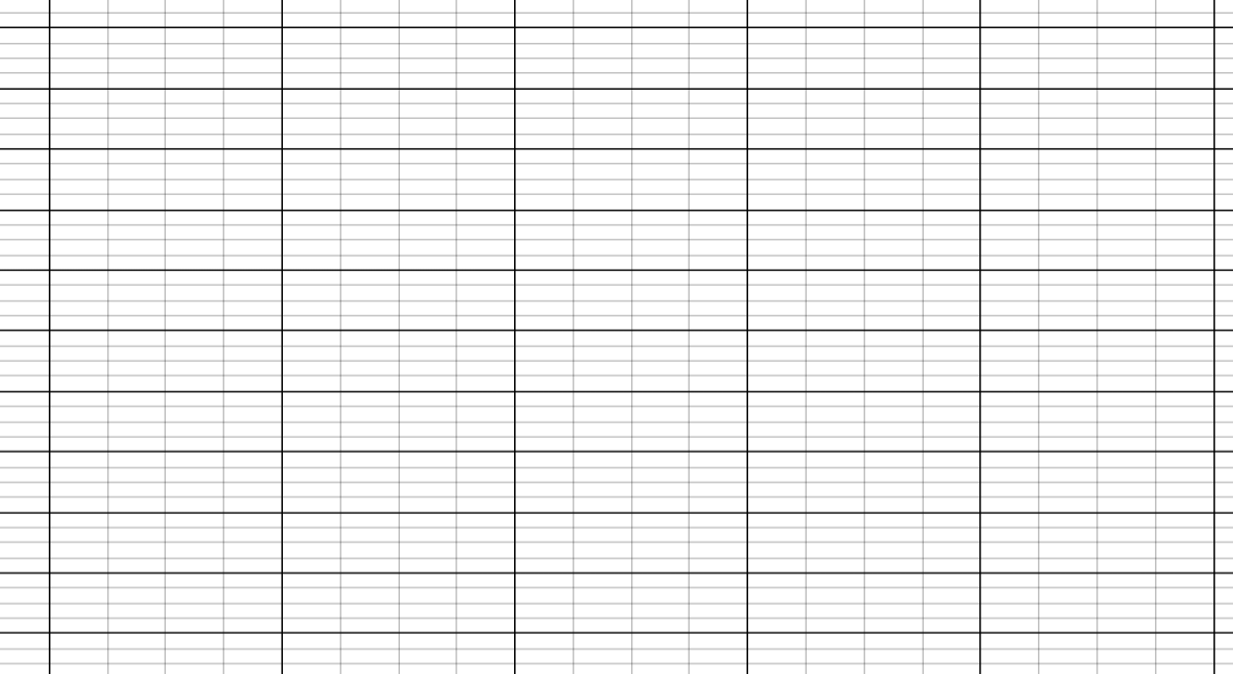
Misleading graphs
Sofia has collected data about people's favourite colour.
10
What is the problem with how this chart is drawn?
8
6
All the bars are different widths.
They have been drawn so they are the same width as the colour name.
Frequency
4
2
0
Red
Blue
Pink
Green
Purple
Why might this be misleading?
Favourite colour
Your eyes are drawn to the wider bars which makes them look bigger than they are.

Slide 18

Misleading graphs
Which of these could be ways to draw misleading graphs?
Draw a bar chart where the bars are equal width.
Draw a 3D pie chart and tilt the angle.
Sometimes labels are deliberately left off of a chart to make it harder for people to interpret them correctly.
Label the axes.
Use a broken scale on the y axis.

Slide 19
Misleading graphs
1) Why might the graph in this advert be misleading?
“Studies show our toothpaste is much more effective at promoting healthy teeth and gums than regular toothpaste.”
Premium toothpaste
Regular toothpaste

Slide 20
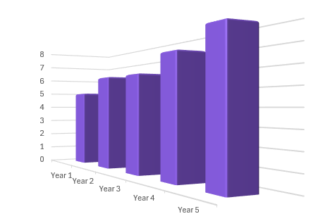
Misleading graphs
2) This chart shows the profit of a company (in thousands) over a 5 year period.
a) What elements of this chart might make it misleading?
Profit (1000s)
b) Why do you think the company chose to draw it this way?

Slide 21

Misleading graphs
3) Jacob records the average temperature in one of his classrooms each month and draws this graph.
a) What conclusion might he be trying to convey with this graph?
✖
26
Classroom temperature (°C)
25
✖
✖
✖
b) Why is his graph misleading?
✖
24
✖
Month
March
April
May
June
July
Sept

Slide 22
Misleading graphs
4) Sofia collects this data on how long she spends on different activities on a Saturday.
Activity | Time
Sleeping | 9 hrs
Exercising | 3 hrs
Seeing friends | 4 hrs
Screen time | 5 hrs
Family time | 3 hrs
a) What type of chart could Sofia draw to display this data?
b) Sofia wants to make it look like she spends lots of time exercising, how could she manipulate her chart to imply this?

Slide 23
Misleading graphs
1) Why might the graph in this advert be misleading?
You may have said:
- No scale on the y axis so the difference in height could be anything.
- The premium toothpaste bar is wider which makes it look like it represents a bigger number.
- No label on the y axis so we do not know what is being measured.
- Use of colour highlights the Premium toothpaste.
“Studies show our toothpaste is much more effective at promoting healthy teeth and gums than regular toothpaste.”
Premium toothpaste
Regular toothpaste

Slide 24
Misleading graphs
2) This chart shows the profit of a company (in thousands) over a 5 year period.
a) What elements of this chart might make it misleading?
Profit (1000s)
A 3D bar chart can make bars in the foreground look like they are bigger.
It is hard to read the exact numbers off the axis.
b) Why do you think the company chose to draw it this way?
To make the yearly profit increase look more impressive.

Slide 25
Misleading graphs
3) Jacob records the average temperature in one of his classrooms each month and draws this graph.
a) What conclusion might he be trying to convey with this graph?
✖
26
It is significantly hotter in the classroom in July.
Classroom temperature (°C)
25
✖
✖
✖
b) Why is his graph misleading?
✖
24
✖
It has a broken scale so cannot use proportions.
Month
March
April
May
June
July
Sept
The scale is stretched, the actual difference in temperatures is only 2.25°C
He misses out August which makes the peak in July look more significant.

Slide 26
Misleading graphs
4) Sofia collects this data on how long she spends on different activities on a Saturday.
Activity | Time
Sleeping | 9 hrs
Exercising | 3 hrs
Seeing friends | 4 hrs
Screen time | 5 hrs
Family time | 3 hrs
a) What type of chart could Sofia draw to display this data?
E.g. Bar chart, Pie chart, Pictogram…
b) Sofia wants to make it look like she spends lots of time exercising, how could she manipulate her chart to imply this?
This will depend on the type of graph but some ideas:
Use a 3D pie chart with exercise at the front and the pie chart at an angle.
On a bar chart leave the numbers off the axis.
Draw a 3D bar chart with exercise in the foreground.

Slide 27
Misleading data
Misleading graphs
Misinterpreting graphs

Slide 28
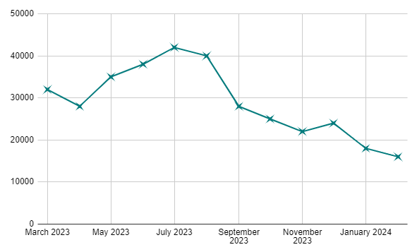
Misinterpreting graphs
We have seen how graphs can be drawn to be misleading.
It can also be very easy to misinterpret graphs or make incorrect conclusions based on a lack of understanding about data.
This time series graph shows the number of passengers at ‘Oakfield Station’.
Total number of passengers
A local newspaper article states, “The number of people using the station is at an all time low.”
Does the graph support this headline?
time

Slide 29
Misinterpreting graphs
A local newspaper article states ‘The number of people using the station is at an all time low.”
The graph only has data for the last year.
It would be incorrect to use this to state passengers are at an all-time low.
It may be the case that the winter months always have fewer passengers.
Total number of passengers
time

Slide 30

Misinterpreting graphs
This graph shows the number of ice creams sold and the number of skateboarding accidents over a series of days.
60
✖
50
✖
✖
Ice cream sales
✖
40
✖
✖
✖
✖
30
✖
✖
✖
✖
✖
Frequency
✖
That’s crazy, the number of skateboarding accidents increase when ice cream sales increase.
✖
Skateboarding accidents
20
✖
✖
✖
10
✖
✖
days
People must be so distracted eating their ice creams that it causes them to fall off their skateboards.
Sofia
Alex
Is Sofia’s conclusion sensible?

Slide 31
Misinterpreting graphs
This graph shows the number of ice creams sold and the number of skateboarding accidents over a series of days.
60
✖
50
✖
✖
Ice cream sales
✖
40
✖
✖
✖
✖
30
✖
✖
✖
✖
✖
It is unlikely that the ice creams are causing the skateboarding accidents.
Frequency
✖
✖
Skateboarding accidents
20
✖
✖
✖
10
✖
✖
It is also unlikely that skateboarding accidents are causing people to buy ice creams.
days
Can you think of a reason why these things may follow a similar pattern?

Slide 32
Misinterpreting graphs
This graph shows the number of ice creams sold and the number of skateboarding accidents over a series of days.
60
✖
50
✖
✖
Ice cream sales
✖
40
✖
✖
✖
✖
30
✖
✖
✖
✖
✖
Weather could be a factor. On sunny days more people buy ice creams and more people are likely to be out on their skateboards.
Frequency
✖
✖
Skateboarding accidents
20
✖
✖
✖
10
✖
✖
days
The day of the week may be a factor as well. More people are likely to buy ice creams on a weekend and they are more likely to be out. The more people out on their skateboards, the higher the chance of accidents.

Slide 33
Misinterpreting graphs
This is an example where two things are correlated but one does not cause the other.
In this case there is likely to be a third factor which affects both in the same way.
It is possible for things to be correlated without there being any connection between them.
It is often possible to manipulate data to show a correlation between two completely unrelated variables.
This can be a particularly tricky idea for scientists to navigate when testing chemicals/ procedures or the effectiveness of medical treatments.

Slide 34
Misinterpreting graphs
If two things are correlated then one must cause the other.
There may be a third factor affecting both or it may be a coincidence or a result of manipulating data in a certain way.

Slide 35
Misinterpreting graphs
1) Alex drew this chart from data he collected about how pupils travel to school.
a) The school newspaper reports, ‘Only 50 pupils walked to school in the 2022/23 academic year’. Is this supported by Alex’s chart?
60
✖
50
✖
40
✖
Percentage of pupils who walk to school
✖
30
b) The headline of the article states, ‘Fewer young people choose to walk to school now than in the past’. Is this supported by Alex’s chart?
20
10
20/21
21/22
22/23
23/24
year

Slide 36
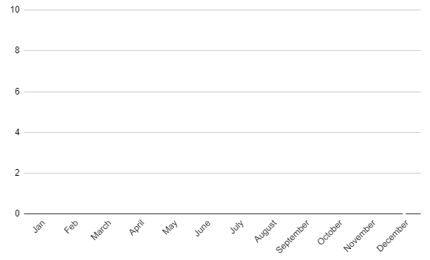
Misinterpreting graphs
✖
✖
2) This time series graph shows the number of shark attacks and the number of heat stroke sufferers throughout the year.
✖
✖
✖
Shark attacks
✖
✖
✖
✖
✖
✖
✖
✖
✖
Cases of heat stroke
✖
✖
✖
The more shark attacks there are the less likely people are to go in the sea so they are more likely to get heat stroke. Shark attacks cause heat stroke!
✖
✖
✖
✖
✖
✖
✖
✖
✖
a) Does the graph support the claim that shark attacks cause heat stroke?
b) Suggest a possible reason why there is a similar pattern between these variables.
Jacob

Slide 37
Misinterpreting graphs
3) Here is a sketch of a scatter graph showing the number of times people visit restaurants and the value of their car.
So all I need to do is eat out more then I will be able to get a fancy car!
Sofia
✖
✖
✖
✖
Value of car
✖
✖
✖
a) Does this graph show correlation between the number of times people visit restaurants and the value of their car? How do you know?
✖
✖
✖
✖
✖
Number of times at a restaurant
b) Explain why Sofia’s statement is incorrect.

Slide 38
Misinterpreting graphs
4) This chart shows the number of people who live in rural areas compared to urban areas.
Alex
This shows twice as many people live in urban areas than rural.
I think it shows that 4 times as many people live in urban areas than rural areas.
Sofia
Rural
Urban
a) Give a reason why Alex may be correct.
b) Give a reason why Sofia may be correct.
c) Give a reason why both may be incorrect.

Slide 39
Misinterpreting graphs
1) Alex drew this chart from data he collected about how pupils travel to school.
a) The school newspaper reports, ‘Only 50 pupils walked to school in the 2022/23 academic year’. Is this supported by Alex’s chart?
60
✖
50
✖
40
✖
Percentage of pupils who walk to school
✖
30
No. The y axis is percentage of pupils who walk to school. 50% of pupils walk to school but we do not know how many pupils this is.
20
10
20/21
21/22
22/23
23/24
year

Slide 40
Misinterpreting graphs
1) Alex drew this chart from data he collected about how pupils travel to school.
b) The headline of the article states, ‘Fewer young people choose to walk to school now than in the past’. Is this supported by Alex’s chart?
60
✖
50
✖
40
✖
Percentage of pupils who walk to school
✖
The chart does seem to show a decrease in the percentage of pupils walking to school, however this chart only goes back as far as 2020 so it is inaccurate to claim that fewer people walk now than ‘in the past’.
30
20
10
20/21
21/22
22/23
23/24
year

Slide 41
Misinterpreting graphs
✖
✖
2) This time series graph shows the number of shark attacks and the number of heat stroke sufferers throughout the year.
✖
✖
✖
Shark attacks
✖
✖
✖
✖
✖
✖
✖
✖
✖
Cases of heatstroke
✖
✖
✖
The more shark attacks there are the less likely people are to go in the sea so they are more likely to get heat stroke. Shark attacks cause heat stroke!
✖
✖
✖
✖
✖
✖
✖
✖
✖
a) Does the graph support the claim that shark attacks cause heat stroke?
These variables follow a similar pattern but this does not mean that one causes the other. This could be a coincidence or both could be influenced by a third factor.
Jacob

Slide 42
Misinterpreting graphs
✖
✖
2) This time series graph shows the number of shark attacks and the number of heat stroke sufferers throughout the year.
✖
✖
✖
Shark attacks
✖
✖
✖
✖
✖
✖
✖
✖
✖
Cases of heatstroke
✖
✖
✖
b) Suggest a possible reason why there is a similar pattern between these variables.
✖
✖
✖
✖
✖
✖
✖
✖
✖
Weather and holidays are likely to influence both variables in a similar way. The warmer it is the higher the likelihood of heat stroke and more people will be swimming in the sea so higher chance of shark attacks.

Slide 43
Misinterpreting graphs
3) Here is a sketch of a scatter graph showing the number of times people visit restaurants and the value of their car.
So all I need to do is eat out more then I will be able to get a fancy car!
Sofia
✖
✖
✖
✖
Value of car
✖
✖
✖
a) Does this graph show correlation between the number of times people visit restaurants and the value of their car? How do you know?
✖
✖
✖
✖
✖
Yes, from the limited data there seems to be a positive correlation. The points lie reasonably close to a linear relationship.
Number of times at a restaurant

Slide 44
Misinterpreting graphs
3) Here is a sketch of a scatter graph showing the number of times people visit restaurants and the value of their car.
So all I need to do is eat out more then I will be able to get a fancy car!
Sofia
✖
✖
✖
✖
Value of car
✖
✖
✖
✖
b) Explain why Sofia’s statement is incorrect.
✖
✖
Just because there is correlation does not mean one variable causes the other. In this case, people with more money are likely to be able to eat out more and buy more expensive cars.
✖
✖
Number of times at a restaurant

Slide 45
Misinterpreting graphs
4) This chart shows the number of people who live in rural areas compared to urban areas.
Alex
This shows twice as many people live in urban areas than rural.
I think it shows that 4 times as many people live in urban areas than rural areas.
Sofia
Rural
Urban
a) Give a reason why Alex may be correct.
The height of the picture for urban areas is twice that of the picture for rural areas.

Slide 46
Misinterpreting graphs
4) This chart shows the number of people who live in rural areas compared to urban areas.
Alex
This shows twice as many people live in urban areas than rural.
I think it shows that 4 times as many people live in urban areas than rural areas.
Sofia
Rural
Urban
b) Give a reason why Sofia may be correct.
The area of the picture for urban areas is four times that of the picture for rural areas.

Slide 47
Misinterpreting graphs
4) This chart shows the number of people who live in rural areas compared to urban areas.
Alex
This shows twice as many people live in urban areas than rural.
I think it shows that 4 times as many people live in urban areas than rural areas.
Sofia
c) Give a reason why both may be incorrect.
Rural
Urban
There is no scale on the y axis, if the scale does not start at zero then comparing proportions is incorrect.
It is impossible to interpret what this graph is showing.

Slide 48
Misleading data
Graphs are often used as they are visually appealing.
They are sometimes drawn to deliberately mislead the reader or influence their opinion.
Some graphs are drawn accurately but interpreted incorrectly.
Just because there appears to be a correlation between two variables does not mean that one variable causes the other.

Slide 49

© Oak National Academy 2024.
Produced in partnership with Mathematics in Education and Industry.
Licensed on the Open Government Licence v3.0, except where otherwise stated. See Oak terms and conditions.

